Slide 1
Broadband Wireless Access Networks
Chapter 14 Broadband Wireless Access Networks
Chapter 14
Week 12
Read the following to prepare for this week:
Chapter 14 in Subramanian, Gonsalves & Rani (2010). You ignore the slides from 33 to 41.
Commercial examples
8 slides removed = 59
Notes:
Chapter 14

Slide 2
Objectives
Chapter 14 Broadband Wireless Access Networks
Broadband wireless access networks
Multichannel multipoint distribution service, MMDS
Local multipoint distribution service, LMDS
IEEE 802.16/WiMax networks
Components of wireless access network
Base station (BS)
Subscriber station (SS)
Wireless medium
Wireless spectrum
Basic principles of wireless communication
Free space propagation
Terrestrial propagation
Cellular mobile environment
Fading phenomena
MMDS and LMDS
Deployment in rural areas
Line-of-sight (LOS) limitation
Operational spectrum and modes
Similarity with cable access network
DOCSIS standards or proprietary protocol
DOCSIS management standards for DOCSIS-based systems
Network Management: Principles and Practice
© Mani Subramanian 2010
*
Notes:
Chapter 14

Slide 3
Objectives (cont.)
Chapter 14 Broadband Wireless Access Networks
IEEE 802.16/WiMax networks
IEEE 802.16 spectrum 10 to 66 GHz
WiMax spectrum windows in the 2 to 11 GHz
WiMax mesh network eliminates LOS limitation
Management of BS and SS
Spectrum management
Service flow management
Management using wmanIfMib
Mobile wireless network
2.5, 3, and 4G technologies
TDM, TDMA, and CDMA protocol systems
Management issues
Use of mobile IP
Mobility management
Power and resource management
QoS management
Security management
VSAT network and management
Network Management: Principles and Practice
© Mani Subramanian 2010
*
Notes:
Chapter 14

Slide 4
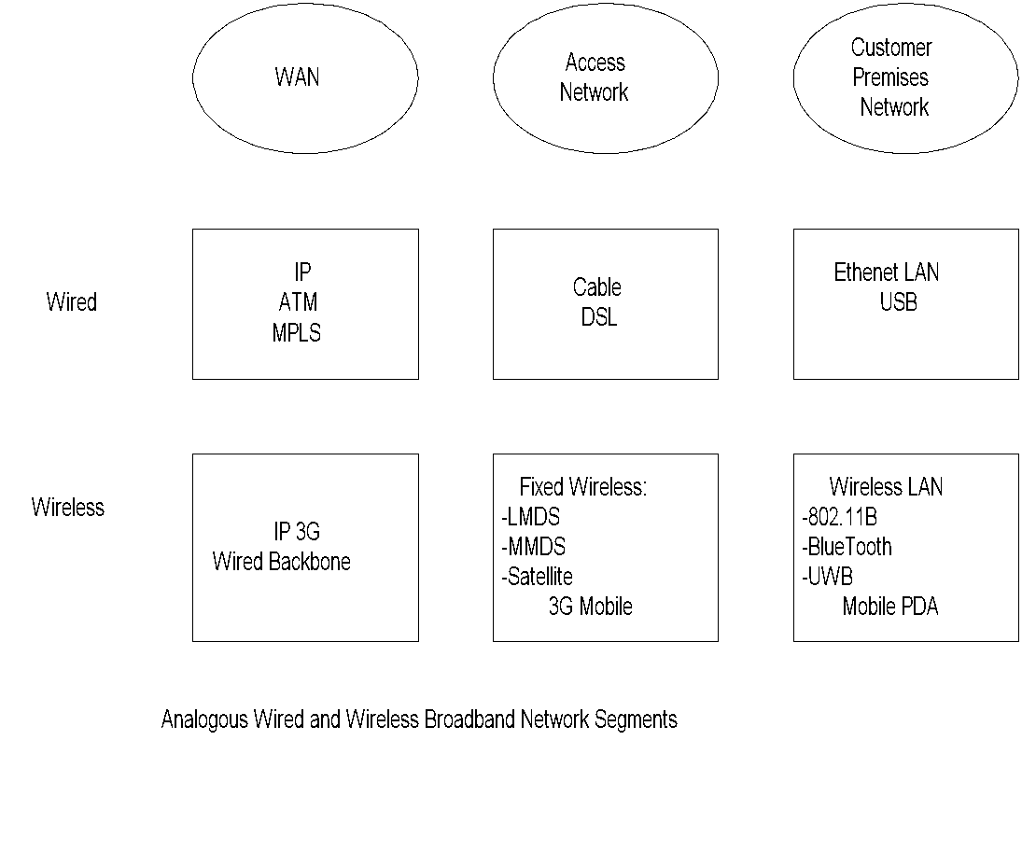
Wired & Wireless Broadband Networks
Chapter 14 Broadband Wireless Access Networks
Notes
Wireless Mobile ATM (WmATM) is not shown in Wireless WAN as it does not appear to be in the current road map of technology.
Notes:
Chapter 14

Slide 5
broadband wireless access (BWA)
We studied basics of broadband wired access networks and their management in the previous chapter.
We will now look at the basics of broadband wireless access (BWA) networks and how they are managed.
Wireless access network has a lot of benefits over wired access networks.
It is easier to install than cable, asymmetric digital subscriber line (ADSL), and passive optical network (PON) networks.
It is more economical as it requires only the installation of a base station (BS).
It is easily scalable in that more subscribers can be added by installing more BSs or more sectors in a BS.
It is demographically adaptable for both rural and urban communities.
However, the BWA network suffers from some major disadvantages of inadequate bandwidth for broadband, data loss, short and shallow fading, and security threat considerations.
All these drawbacks are further complicated by the lack of a common management system that can remotely and centrally manage multi wireless technologies and multivendor products.

Slide 6
broadband wireless access (BWA)
The application of wireless technologies can be grouped into three categories.
They are personal area networks (PANs), wireless LANs (WLANs), and access networks — metropolitan area network (MAN), GPS/general packet radio service (GPRS), and code division multiple access (CDMA) are represented in Figure 14.1.
The PAN is a short-range mobile network that covers a range in the order of tens of feet. It is primarily used for device applications with transmitters and receivers being mobile.
The WLAN, a good example of which is Wi-Fi, is used primarily inside buildings as customer premises equipment (CPE) or home network. It has a reach of several hundreds of meters.
The third category is broadband and narrowband access networks that are deployed as both fixed and mobile networks. Their reach is several kilometers and is deployed outside.
Examples of mobile cellular networks are global system for mobile communications (GSM), GPRS, and CDMA.
Fixed wireless networks, such as the MAN, are deployed as BWA networks in cities with antennas over the roof top of buildings. This can be deployed as a mesh network.
Point-to- multipoint BWA network is deployed using different technologies and using different spectral bands. They are deployed in both metropolitan and rural areas.
The third category is the subject of this chapter.

Slide 7
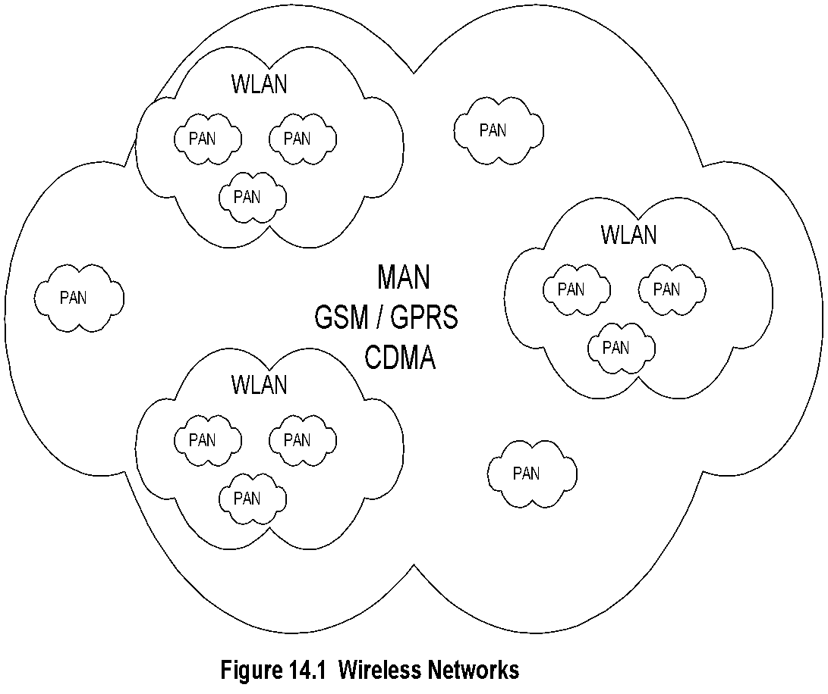
Wireless Broadband Networks
Chapter 14 Broadband Wireless Access Networks
Notes
Three categories:
Wireless LAN (WLAN)
Personal Area Network (PAN)
Access Networks
MAN a.k.a. WiMax
Notes:
Chapter 14

Slide 8
Basic Principles
Chapter 14 Broadband Wireless Access Networks
Notes:
Chapter 14

Slide 9
14.1 BASIC PRINCIPLES
Wireless propagation for access network, fixed wireless, also known as wireless local loop (WLL), and cellular mobile wireless are discussed in this section. There are several physical mechanisms to consider in dealing with wireless propagation, which we do not have with propagation through wired networks.
For outdoor propagation, shown in Figure 14.2, the physical mechanisms that we need to consider are line-of-sight (LOS) path, reflection, and diffraction-from ground and other stationary and moving objects-and scattering such as from foliage and buildings.
Let us compare wired media with wireless media:
We can list the following three main characteristics of wired media that adversely سلبا affect broadband propagation.
First is attenuation, which is based on conductivity in copper, or reflection and refraction losses in fiber.
The next characteristic is frequency and phase dispersion that are dependent on the refractive index, which in turn is dependent on frequency.
The third is time dispersion caused by the speed of transmission, which is dependent on the dispersive refractive index.
Manifestations of the above adversely impacting characteristics of wired media are also present for wireless media.
There is attenuation due to absorption by the media, such as water vapor or obstruction of the LOS between the source and the destination such as trees and buildings.
There is also decreasing signal strength as we move away from the source antenna since open-space wave propagation is not guided but is divergent.
The major cause of frequency, phase, and time dispersion can all be attributed to the signal from the source arriving as multiple signals at the receiver by the multipath.
They arrive at the receiver at different times, with changes infrequency and phase, causing interference of short and long duration. If it is a rapid change, it resembles phase, frequency, and time dispersion.
If it is gradual and the signal strength degrades, it is called fading. Fading can be slow or rapid temporally or could be spatially fluctuating.
Frequency shift is due to Doppler effect when the source or the receiver moves fast with respect to each other.

Slide 10
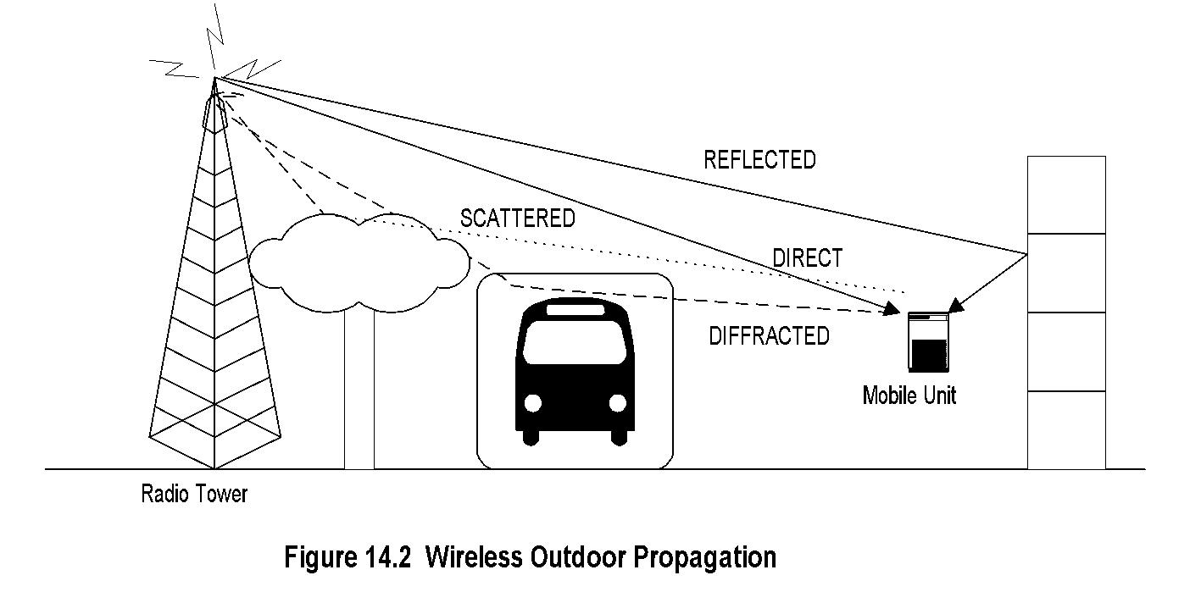
Outdoor Propagation
Chapter 14 Broadband Wireless Access Networks
Notes
Adverse Characteristics الخصائص السلبية:
Attenuation
Dispersion: Frequency and Phase (independent of refractive index)
Dispersion due to refractive index
Decreasing signal strength due to beam pattern
Water absorption
Fading: short and long
Doppler effect
توهن
تشتت
تشتت بسبب معامل الانكسار
انخفاض قوة الإشارة بسبب نمط الموجة
امتصاص الماء
يتلاشى: قصيرة وطويلة
تأثير دوبلر
Notes:
Chapter 14

Slide 11
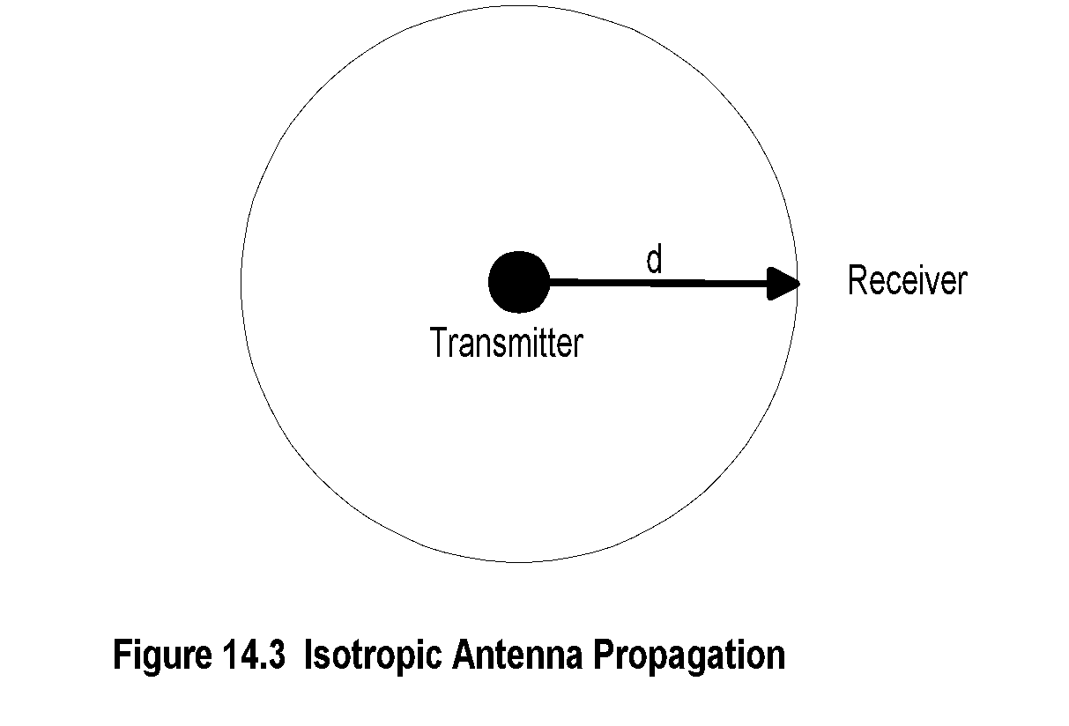
Isotropic Propagation متماثل
Chapter 14 Broadband Wireless Access Networks
Let us first consider the signal strength, which varies with distance from the source in free space.
This is shown in Figure 14.3 for an isotropic antenna.
The power at distance d from the source is given by
P_{r} = (P_{T} / 4πd²) watts /m² (14-1)
P_{r} = Received power per unit area
P_{T} = Total transmitted power.
Notes
Pr = (PT / 4πd²) watts /m² (14-1)
Pr = Received power per unit area and
PT = Total transmitted power.
Isotropic has the same value when measured in different directions.
Notes:
Chapter 14

Slide 12
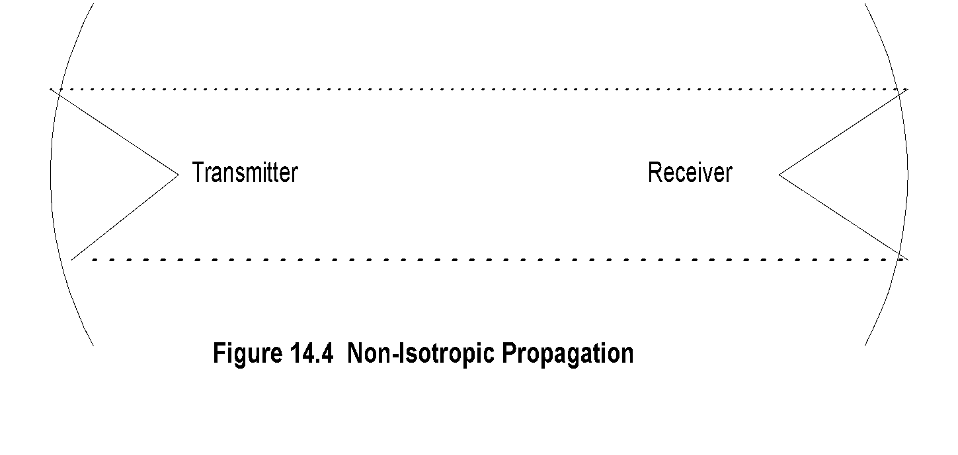
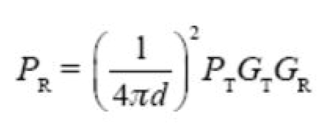
Non-Isotropic Propagation
Chapter 14 Broadband Wireless Access Networks
Figure 14.4 shows configuration of non-isotropic propagation between the transmitter and the receiver antenna of finite size.
For a given effective receiver antenna size, Ar, and receiver efficiency, //r, the total received power, Pr, for an isotropic transmitter antenna is
Notes
P_{R} = P_{T}G_{T}G_{R} (λ / 4d)² (14-5)
P_{R} = Received power
P_{T} = Transmitted power
G_{T} = Transmitter antenna gain
G_{R} = Receiver antenna gain
λ = Wavelength
Notes:
Chapter 14

Slide 13
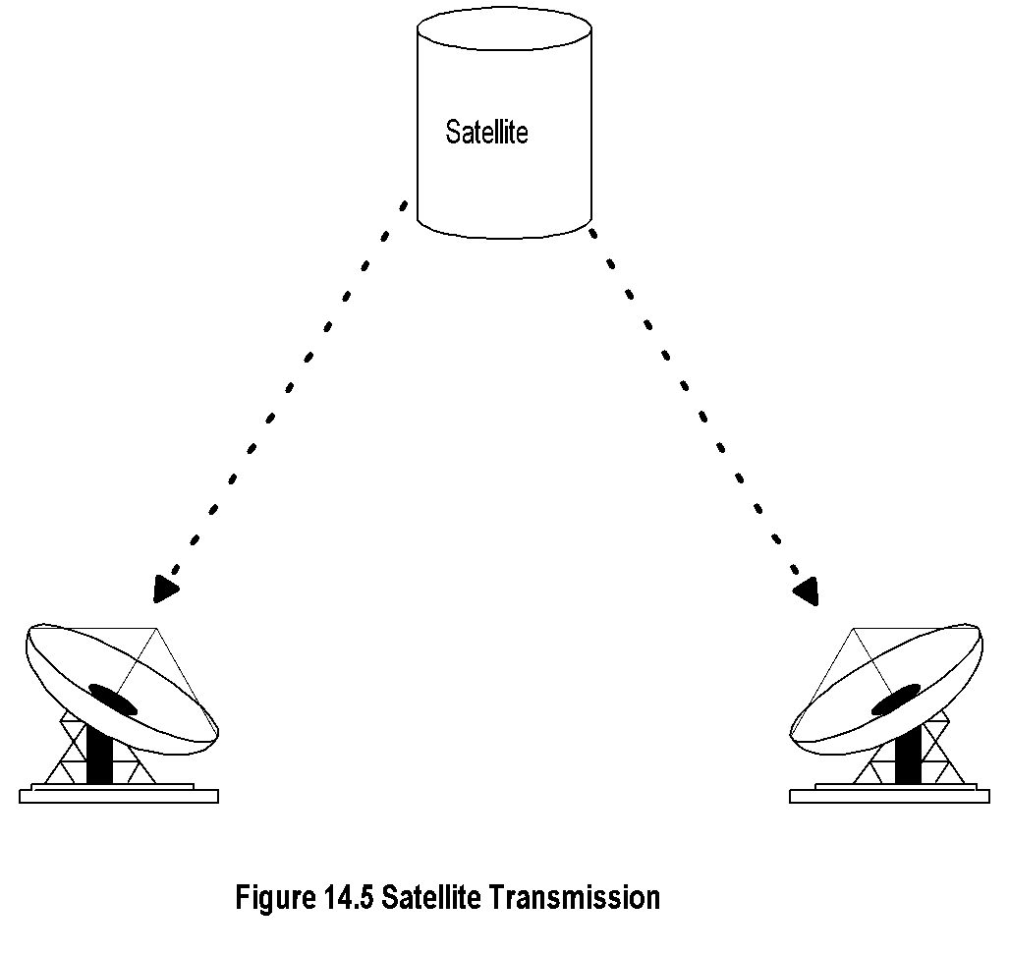
Satellite Free Space Propagation
Chapter 14 Broadband Wireless Access Networks
Notes
Define P0 = power received at the first meter (d = lm). Then:
P_{R} = 1/d²
Notes:
Chapter 14

Slide 14
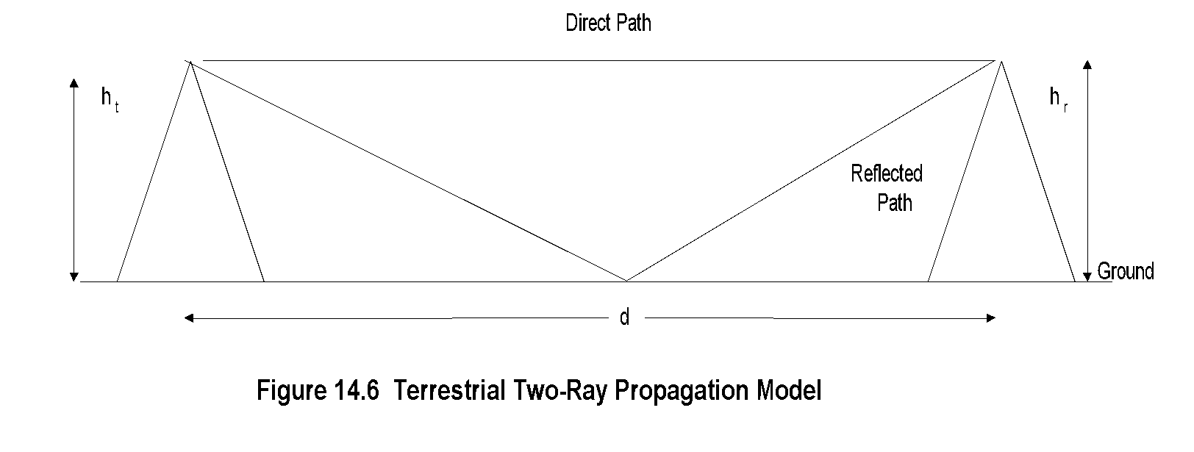
أرضي Terrestrial Propagation
Chapter 14 Broadband Wireless Access Networks
Two-Ray Propagation:
The free-space propagation model derived in Section 14.1.1can be applied to satellite propagation. However, it does not apply to the terrestrial propagation model. Figure 14.6 shows a simple terrestrial propagation model. The signal travels from the transmitter to the receiver along two paths. The first is a direct path and the other an indirect path caused by ground reflection.
Notes
P_{R} ά 1/d²
Notes:
Chapter 14

Slide 15
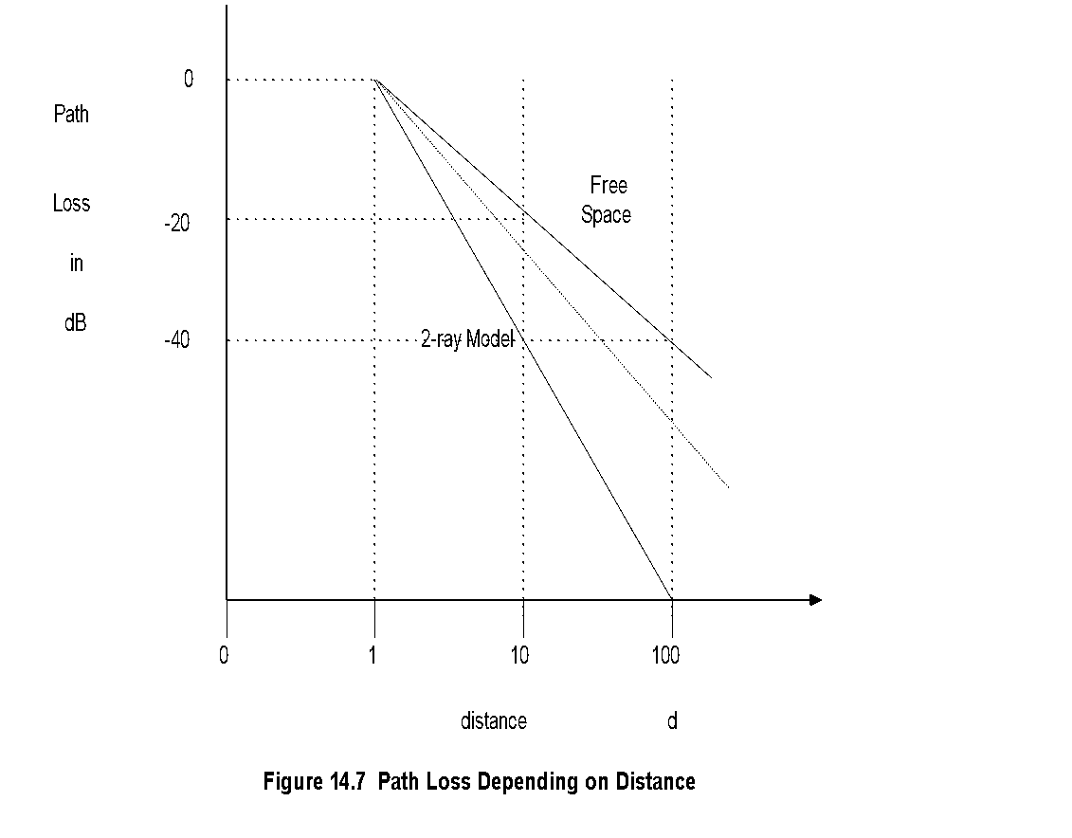
Path Loss Dependency
Chapter 14 Broadband Wireless Access Networks
Figure 14.7 shows the two cases. In the real world, distance dependency would transition between the two cases as either the distance is increased or the height of the antenna is varied.
Notes
Notes:
Chapter 14

Slide 16
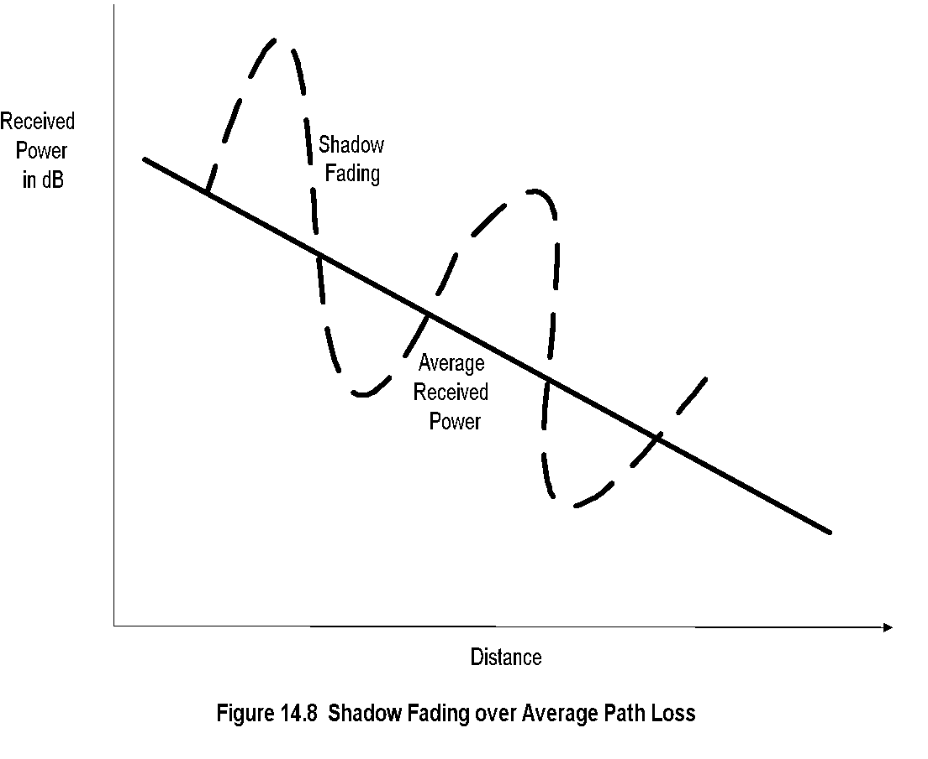
Shadow Fading
Chapter 14 Broadband Wireless Access Networks
Fading Various factors contributing to fading phenomena in outdoor wireless propagation were presented in Figure 14.2. All of them impact the instantaneous value of the received signal that is varying temporally and spatially.
The magnitude of the received power fluctuation is caused primarily either by path loss due to absorption and scattering, or due to multipath fading caused by the interference of direct wave with reflected, diffracted, or scattered waves.
The fading phenomenon has both spatial and temporal dependencies. We can classify them into large-scale fading and small-scale fading. The former occurs at a slow spatial rate compared to the wavelength and is generally slow in temporal variation. The latter, namely small-scale fading, occurs at spatial dimension comparable to the wavelength and generally occurs at a more spatially rapid rate compared to large-scale fading.
In addition to the above two classifications, there is fading due to Doppler effect in fast-moving mobile units.
Shadow Fading. Large-scale fading, which occurs at relatively long distances compared to wavelength, is also called shadow fading. It is caused due to reflection, scattering, diffraction, meteorological change such as absorption, etc.
The fading follows a log-normal (Gaussian) distribution with a standard deviation of 6-10 dB around average power, as shown in Figure 14.8.
Notes
Large-scale fading
Slow spatial rate compared to wavelength
Slow rate of change
Small-scale fading or Shadow fading
Spatial dimension comparable to wavelength
Rapid rate of change
Notes:
Chapter 14

Slide 17
Cellular Configuration in a Wireless System.
Wireless propagation environment can be classified based on the range and range dependency of the BS. An area served by a BS is called a cell, and a total wireless system is designed using multiple cells.
Free-space propagation described earlier, which is applicable to satellite wireless, could cover a very large area depending on the powder of the transmitter, height and distance of the satellite, and the beam width of the antennae of the transmitter and the receiver.
Terrestrial wireless propagation can be broadly split into macrocellular areas and microcellular areas.
macrocellular cover an area of a few kilometers to tens of kilometers. Small-scale fading in the macrocell is empirically found to follow* Raleigh distribution.
Microcells typically cover a range of up to a kilometer and operate in the frequency spectrum of up to 11 GHz; commercial deployments include WiFi (2.4 GHz) and WiMax (2.1GHz). The
Small-Scale Fading is caused by multipath fading, which is constructive or destructive interference of signals arriving at the receiver traversing different paths and hence at different phases.
Another technique is to use OFDM using Fourier analysis techniques. This ensures that each peak or maximum of a digital signal coincides with the valleys or zeros of the rest of the digital signals in the spectrum. This technique is used in all wireless access systems.
A third method is to use the multiple input multiple output (MIMO) technique. This method takes advantage of multi path fading. It uses multiple antennas to transmit and receive the same signals and recover them using correlation techniques. Frequency, spatial, and temporal diversity spread signal can be reconstructed and fading mitigated.
A fourth technique is to introduce equalization in receivers based 011 a priori knowledge of the distortion of the signal.

Slide 18
Fixed Wireless Networks
Chapter 14 Broadband Wireless Access Networks
Network Management: Principles and Practice
© Mani Subramanian 2010
*
Notes:
Chapter 14

Slide 19
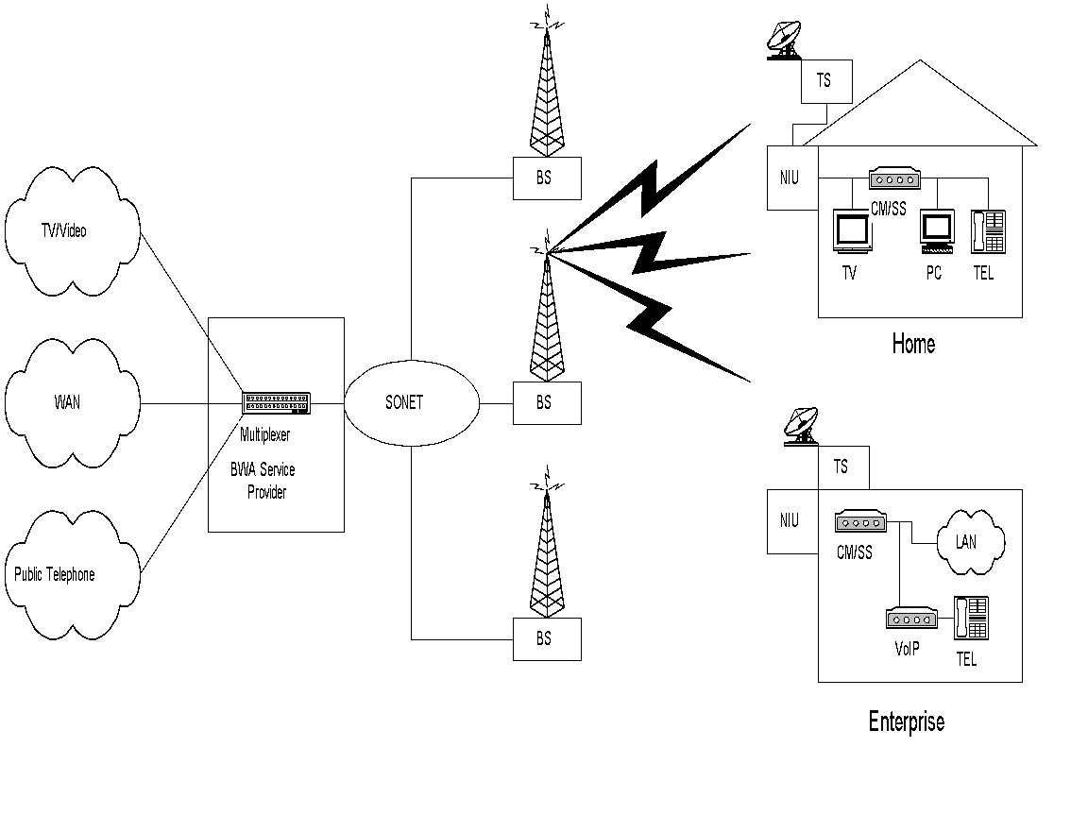
Fixed Wireless Network شبكة لاسلكية ثابتة
Chapter 14 Broadband Wireless Access Networks
A fixed BWA network is used to reach subscribers by wireless medium for the last mile and is shown in Figure 14.9. It is a point-to-multipoint network architecture.
Broadband information comprising voice, video, and data is multiplexed at the BWA service provider head end and is carried over wired WAN or MAN to the BS from where it is transmitted to subscriber premises. Typical residence and Small Office Home Office (SOHO) subscribers are represented in Figure 14.9. The signal at the subscriber premises is up- and down-converted by transreceiver TR to the baseband signal.
The network interface unit (NIU) serves the same function as the NIU in the cable modem system and is the demarcation point between the access network and the subscriber distribution network.
At CPE, the network comprises of analog TV and digital network components. The NIU interfaces with either a subscriber station (SS) or a wireless modem (WM), both of which output Ethernet protocol to the CPE distribution network. The former is used with the IEEE 802.16 standard protocol access network. The latter uses a wireless modem termination system (WMTS) at the head end.
In this case, the only difference between the fixed wireless system and the cable modem system is the transmission medium of the access network.
Figure 14.9 Fixed Wireless Access Network
Notes
Fixed wireless access
a.k.a wireless local loop
Point-to-multipoint network architecture
Benefits:
Less capital investment
Quick and cheap to install and operate

Slide 20
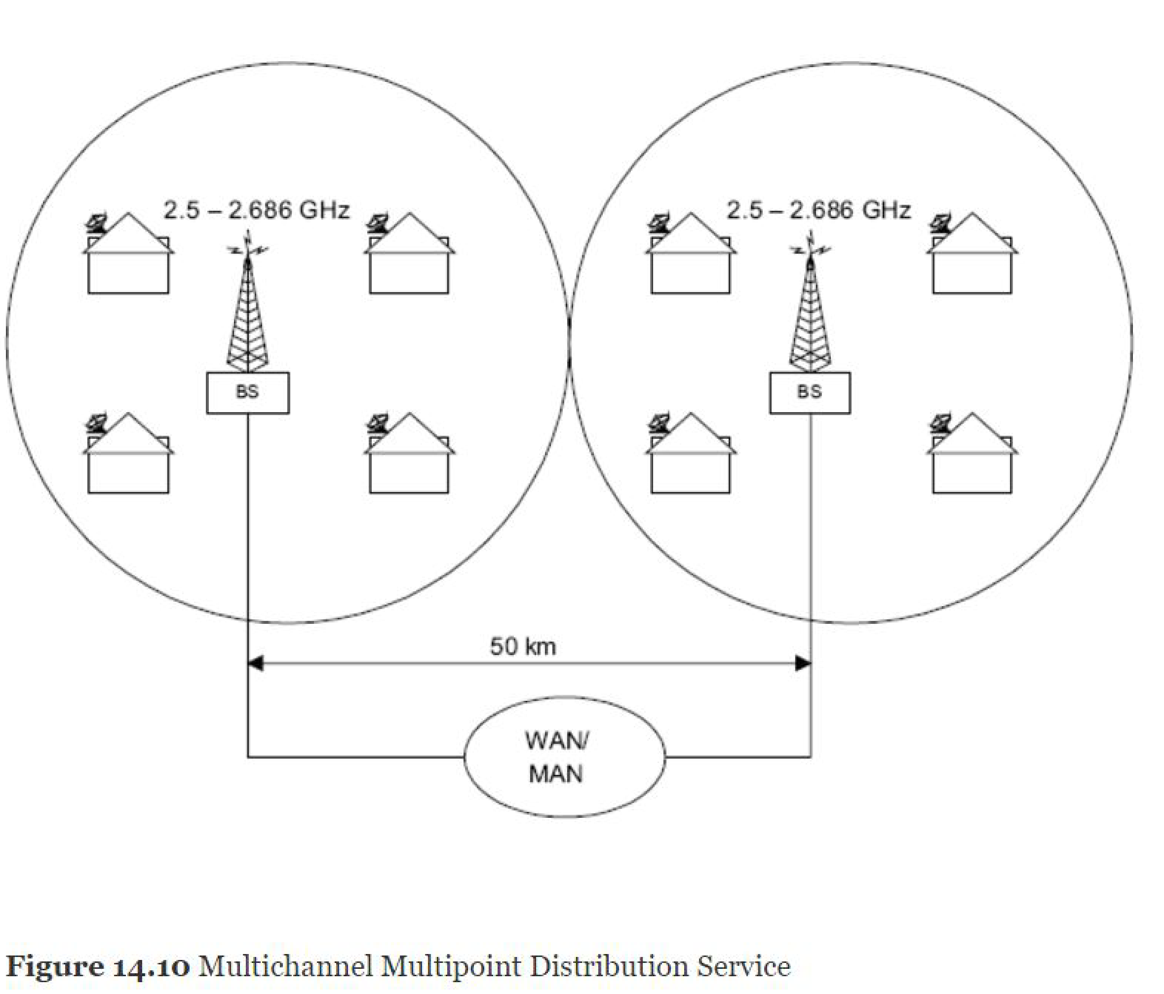
MMDS Network
Chapter 14 Broadband Wireless Access Networks
Multipoint multichannel distribution service (MMDS) is based on point-to-multipoint network architecture.
We can visualize the MMDS system as the cable modem system with the HFC medium replaced by wireless.
An MMDS broadband system shown in Figure 14.10 comprises a head end. which is the BS, antennas at the head end and at the SS, transreceivers that convert the baseband signal to the microwave signal, and the cable modem at the subscriber end that converts DOCSIS+ protocol to Ethernet protocol for a CPE distribution network.
The range of a BS is about 25 kilometers, and hence BSs are separated by about 50 kilometers. The broadband signal is brought to the BSs via WAN or MAN. The range can be extended by having repeater stations, which enables low-powered systems to be used at the SS.
Downstream propagation is TDM broadcast mode and upstream is TDMA transmission.
Downstream modulation is QAM and upstream is QPSK. The system is ideal for rural areas المناطق الريفية. When it is used in the metropolitan area, the LOS is not always good and OFDM modulation is used to mitigate the problem.
Notes
Point-to-multipoint architecture
Range between BSs is 50 km
Operates over 2.5 to 2.686 GHz band
Could operate on multichannels and hence capable of providing 2-way high-speed communication
An implementation using cable modem equipment at both ends
SS = subscriber station

Slide 21
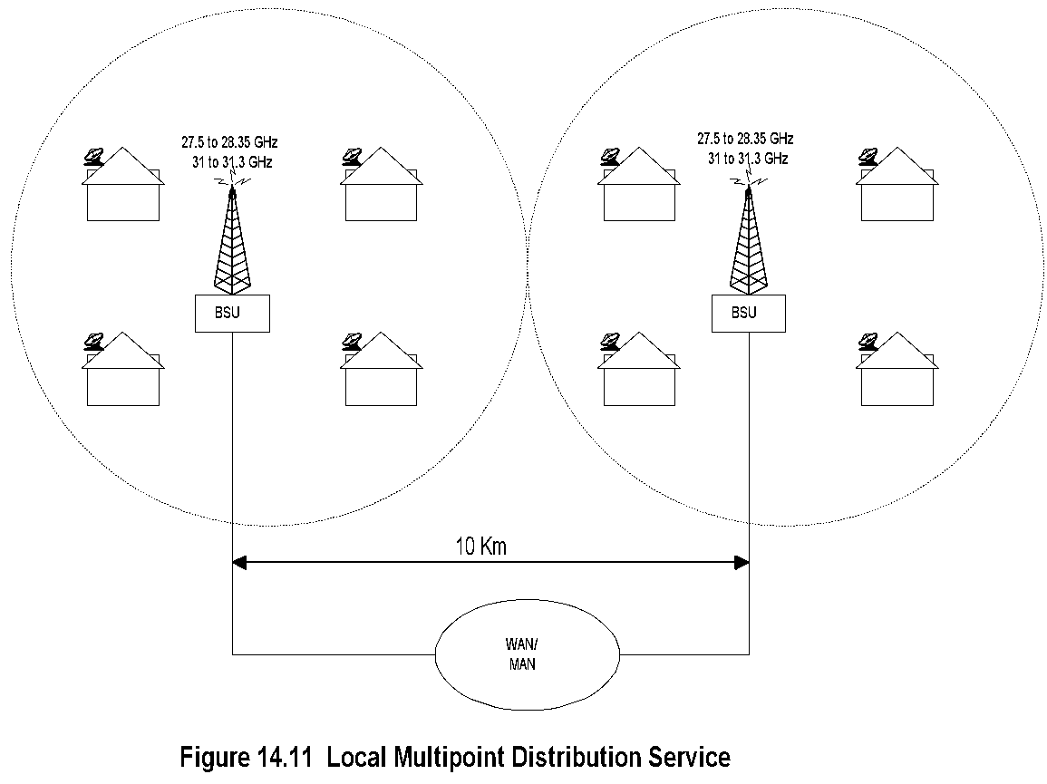
LMDS Network
Chapter 14 Broadband Wireless Access Networks
Local multipoint distribution service (LMDS) is a last-mile broadband access network that operates in the K band spectrum, primarily in the 20-40 GHz band.
The architecture of LMDS is the same as MMDS. Its range is shorter than MMDS, about 5 kilometers and hence BSs are separated by about 10 kilometers, as shown in Figure 14.11.
One reason for the range limitation is due to the absorption of millimeter waves in the LMDS spectrum by precipitation.
LMDS implementation involves a cluster of cells with a BS in each cell. One of the BSs serves as the coordinating station and acts as the gateway to external networks. As in all fixed BWA networks, inter-cell communication is via WAN or MAN.
BS to SS communication is TDM downstream and TDMA upstream.
However, in point-to-point uplink connectivity, other technologies like GPRS are also used.
Notes
Point-to-multipoint architecture
Covers 5 km radius; BSUs spaced 10 km apart
Operates over 27-28.35 and 31-31.3 GHz bands
Sensitive to rain attenuation
Deploys cable modem equipment at both ends

Slide 22
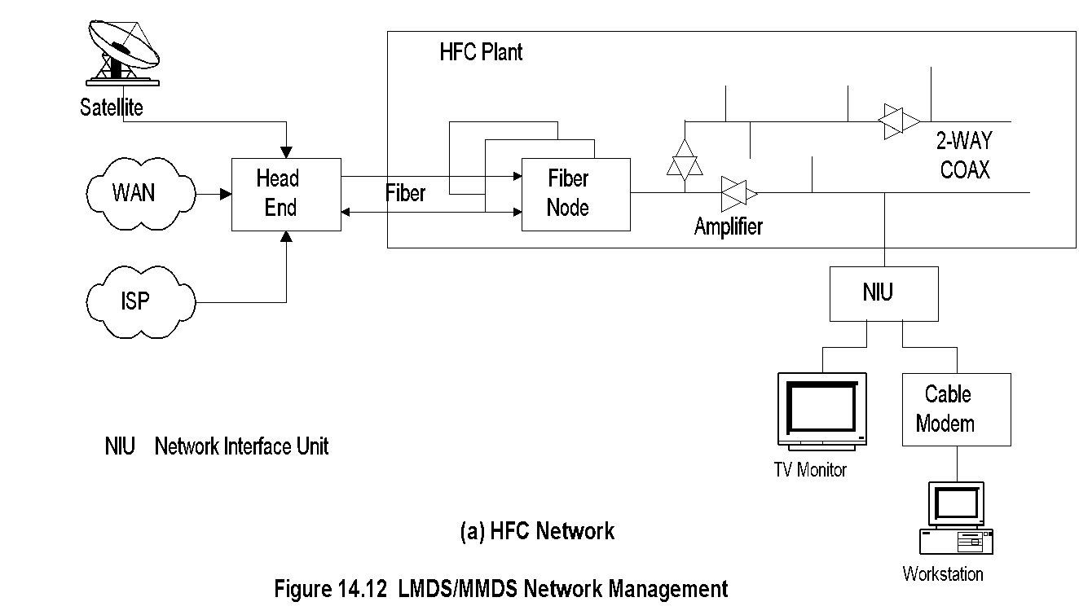
MMDS and Cable Network Management
Chapter 14 Broadband Wireless Access Networks
LMDS and MMDS have adapted the DOCSIS standards from the cable modem world.
DOCSIS modified for wireless broadband is known as DOCSIS+.
The management of MMDS and LMDS in these cases can be pictured as the wireless medium replacing the HFC medium, as shown in Figure 14.12.
At the head end, CMTS is replaced with a WMTS and the CM is replaced with a WM.
DOCSIS+ reduces theft-of-service vulnerabilities under MMDS by requiring that the WMTS
enforce encryption
Notes
MMDS managed using DOCSIS (Data-Over- Cable Standard Interface Specifications)
Head end:
Signals from multiple sources multiplexed
Frequency conversion for local signal
NIU demarcation point between customer and service provider networks
Cable modem: RF-to-Ethernet conversion

Slide 23
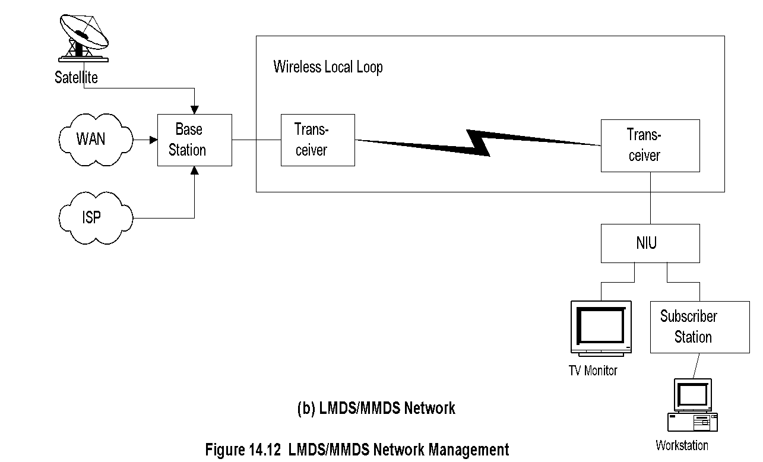
MMDS / LMDS Network Management
Chapter 14 Broadband Wireless Access Networks
Notes
Head end is replaced by base station
Cable modem replaced by transceiver and subscriber station
HFC plant replaced by wireless
DOCSIS standards used for the system
DOCSIS management standards adapted for management

Slide 24
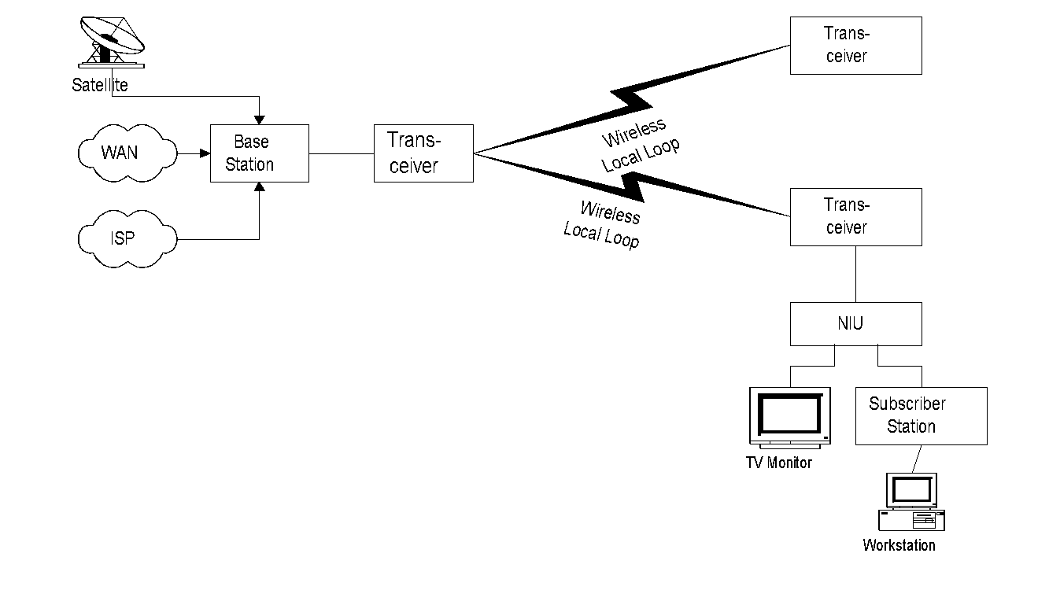
802.16 Fixed Wireless System
Chapter 14 Broadband Wireless Access Networks
SS = subscriber station
Head end transmission is sectionalized with multiple antennas.
Transceivers TS convert the RF signal to the baseband as receivers and vice versa as transmitters at both ends.
The SS performs a similar function as the cable modem but is more complex than the cable modem. Itis designed as a highly directional antenna to minimize the transmitter power.
Figure 14.13 IEEE 802.16 Fixed Wireless System
Notes
IEEE 802.16.1 specifications for 11 GHz to 66 GHz @ 2 to 155 Mbps with flexible asymmetry
Encompasses multiple end configurations and transmission modes
Point-to-multipoint architecture
Early implementation based on cable network
HFC medium replaced with wireless carrier
Transceivers perform up-conversion and down-conversion
Subscriber station a more complex modem than CM
Base station functions as enhanced CMTS
TDMA (Time Division Multiple Access) downstream transmission
DAMA (Demand Assigned Multiple Access) – TDMA upstream transmission

Slide 25
802.16 Base Station (BS)
Chapter 14 Broadband Wireless Access Networks
802.16 uses sector technology for base station antenna (HFC uses tree topology)
Point-to-multipoint transmission
All SSs in a cell terminated at the head end
Downstream in broadcast mode
Upstream transmission by DAMA-TDMA
Allocates bandwidth requested by SS to meet QoS
Gateway to the external (core) network
Multiplexes and demultiplexes signals
Frequency converts upstream to downstream signals in FDD (Frequency Division Duplex)
Can be designed either as a bridge or router
Notes

Slide 26
802.16 Subscriber Station (SS)
Chapter 14 Broadband Wireless Access Networks
Highly directional antenna
DOCSIS 1.1 (and beyond) compliant CM used with primary upstream service flow
Downstream in broadcast mode
Upstream transmission by CM/SS coordinated by head end
Notes

Slide 27
IEEE 802.16 Extensions
Chapter 14 Broadband Wireless Access Networks
IEEE 802.16a
2 to 11 GHz; Supports mesh deployment
IEEE 802.16b
5 TO 6 GHz; Real-time DiffServ service
IEEE 802.16c
10 to 66 GHz
IEEE 802.16d
Improvement over 802.16a
IEEE 802.16e (future)
Std networking between carrier base stations
High-speed handoff with moving vehicles
Notes

Slide 28
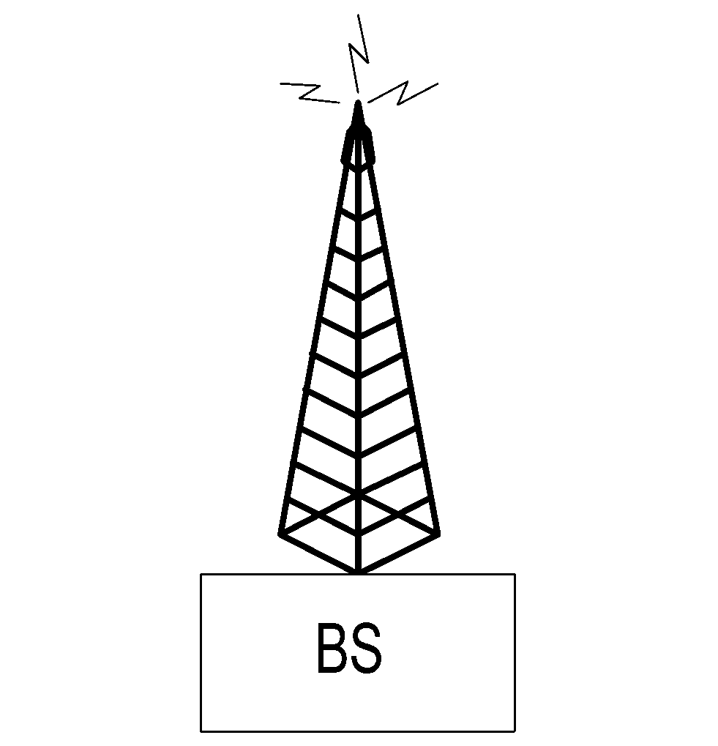
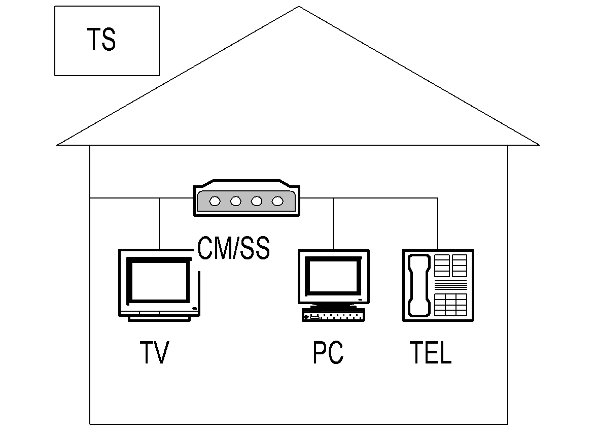
802.16d WiMax
Chapter 14 Broadband Wireless Access Networks
WiMAX (Worldwide Interoperability for Microwave Access) is a wireless industry coalition dedicated to the advancement of IEEE 802.16 standards for broadband wireless access (BWA) networks.
Orthogonal frequency division multiplexing (OFDM) is a technique, method or scheme for digital multi-carrier modulation
WiMAX specifications are defined by IEEE802.i6d, which is a modification of 802.16a and 802.16c.
OFDM technology is used at the PHY layer to improve performance.
Ina metropolitan area, where antennas are positioned over the rooftops of buildings, the network is configured as mesh network, as shown in Figure 14.14. In this case, obstruction of signal between any two antennas is overcome. If a direct LOS path is not available, the system will redirect traffic through intermediate nodes.
Figure 14.14 WiMax Mesh Network
Notes
WMAN … Wireless Metropolitan Network
802.16a can support no-line-of-sight access (unlike 802.16)
802.16a operated in the frequency lower range of 2 – 11 GHz and thus supports both licensed and unlicensed spectrum
Modulation scheme is OFDM as in 802.11a and 802.11g
Support for mesh architecture.

Slide 29
802.16d: PHY Layer
Chapter 14 Broadband Wireless Access Networks
Air interface Wireless MAN-
SCa Single carrier
OFDM (commonly adopted) 256-carrier OFDM TDMA upstream
OFDMA 2048-carrier OFDM Upstream OFDMA – multiple carriers assigned to a receiver
Modulation and decoding
QPSK
16-QAM
64-QAM
Adaptive antenna system
Directed beams in PMP (Point-to-Multipoint)
Channel quality feedback from SS to BS
Notes

Slide 30
802.16d: MAC Layer
Chapter 14 Broadband Wireless Access Networks
Supports mesh network
Two sublayers
Convergence-specific: transport-specific
Common: independent of transport mechanism
Notes
Network Management: Principles and Practice
© Mani Subramanian 2010
*

Slide 31
Fixed BWA (Broadband Wireless Access) Management
Chapter 14 Broadband Wireless Access Networks
Components to be managed:
CM/SS management
BS management
Wireless link management
RF spectrum management
802.16 Recommendation OSI standards
FCAPS functions managed
Notes
We will now describe management of IEEE 802.16 and IEEE802.i6d, WiMAX/Wireless MAN, in this section.
The components to be managed are BS, SS, wireless link, and RF spectrum.

Slide 32
Class of Service and QoS
Chapter 14 Broadband Wireless Access Networks
802.16.1 supports classes of service with various QoS for bearer services
Bandwidth negotiation for connectionless service
State information maintainable for connection-oriented service
ATM Traffic categories:
CBR, VBR-rt, VBR-nrt, ABR, ABR
IETF Traffic categories: (Integrated services RFC 1633 and differentiated services RFC 2475)
Elastic:
Interactive bursts (Telnet)
Interactive bulk (FTP)
Asynchronous bulk (email)
Real-time
Guaranteed service (audio and video conferencing)
Predictive service (video playback)
Notes

Slide 33
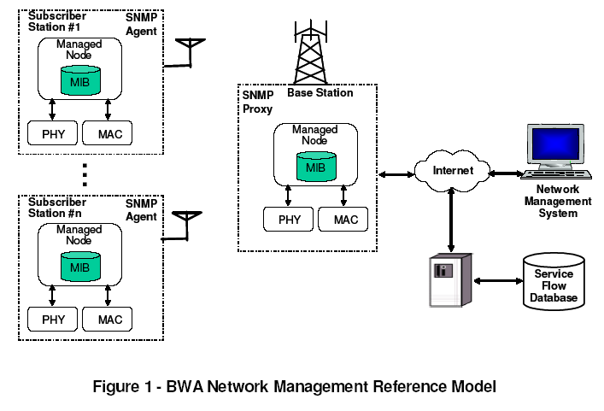
BWA NM Reference Model
Chapter 14 Broadband Wireless Access Networks
Figure 14.15 shows the management reference model of BWA networks.
It consists of a network management system (NMS), managed nodes BS and SSs, and a service flow- database. The service flow database contains service flow and associated QoS information that have to be populated in BS and SS when service is provisioned, or a mobile SS roams into BS coverage. SSs can be managed directly by NMS, or indirectly through BS, acting as the SNMP proxy. Management information between SS and BS will be carried over second management connection ID(CID) for managed SS. If the second management CID does not exist, SNMP messages will go through another interface in the customer premises. The SNMP agent in the SS can be managed directly or via an SNMP proxy in the BS.
Figure 14.15 BWA Network Management Reference Model
Notes
Reference: “MAC and PHY MIB for WirelessMAN and WirelessHUMAN BS and SS,” IEEE C802.16mgt-04/04r1, http://ieee802.org/16

Slide 34
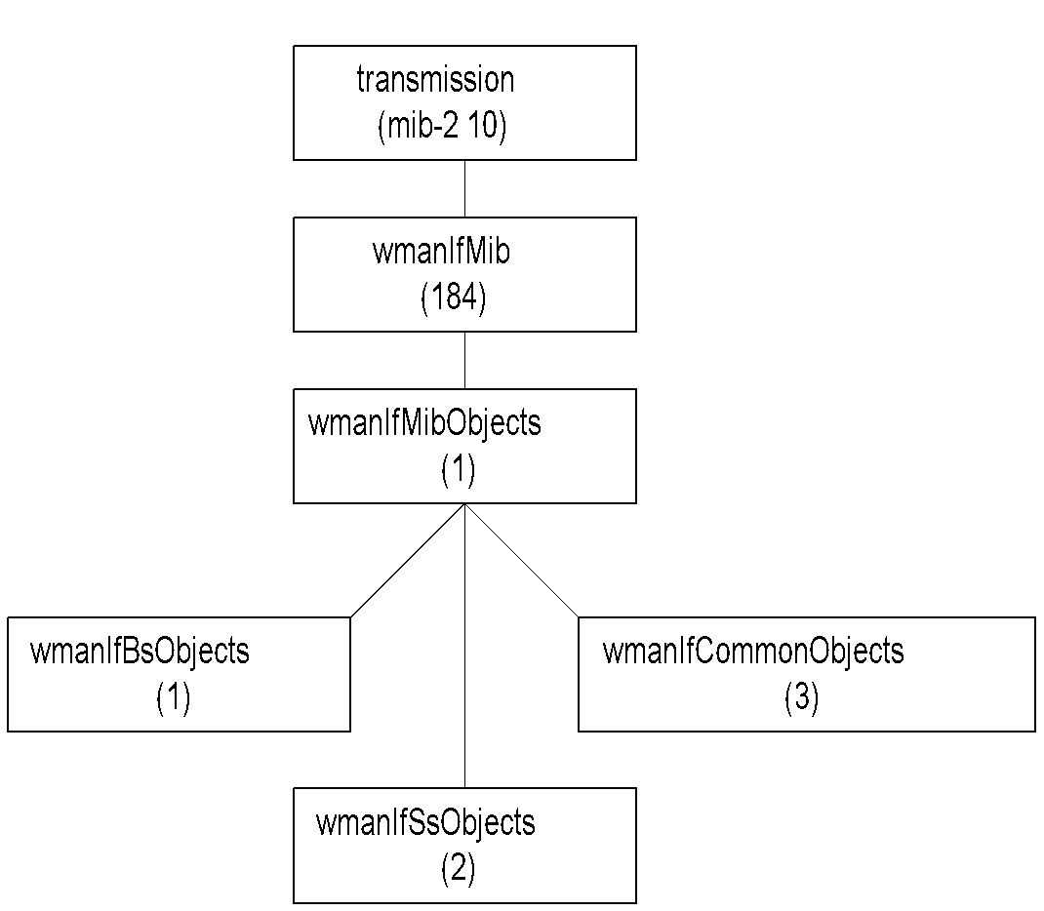
WMAN IF MIB
Chapter 14 Broadband Wireless Access Networks
Figure 14.16 shows the MIB structure of wmanlfMib for 802.16
It defines the interface table for a wireless MAN interface.
Table 14.1describes some key attributes of BS in the wmanlfMib. There are controllers associated with the BS and sectors. The SNMP agent can be implemented in the BS controller or sector controller. There is one entry for each BS if the SNMP agent is implemented in common BS controller. There is only one entry for the BS sector if the SNMP agent is implemented in the sector controller. This is shown in Table 14.1. The usage table for the SS is shown in Table 14.2.
Figure 14.16 WMAN IF MIB
Notes

Slide 35
Usage of ifTable Objects for Base Station BS
Chapter 14 Broadband Wireless Access Networks
Table 14.1 Usage of ifTable Objects for the Base Station
Notes
SNMP agent in a common base station controller: Each BS sector will have an entry in the ifTable
SNMP agent in the sector controller: One entry for the BS sector in the ifTable

Slide 36
Usage of ifTable Objects for Subscriber Station SS
Chapter 14 Broadband Wireless Access Networks
Table 14.2 Usage of ifTable Objects for the Subscriber Station
Notes

Slide 37
Commercial Examples
Chapter 14 Broadband Wireless Access Networks
CorDect / CorVan
Ricochet
Broadband Solutions
MeshNetworks
PacketHop
Navini
Notes
Network Management: Principles and Practice
© Mani Subramanian 2010
*

Slide 38
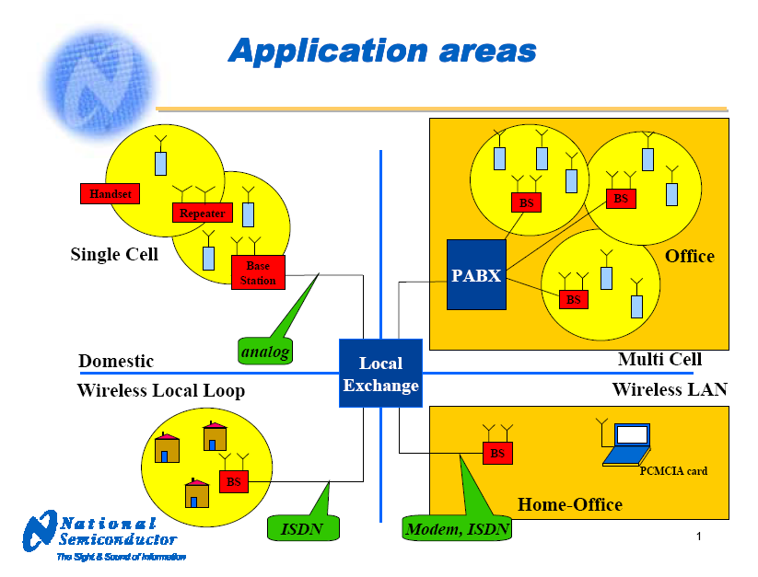
DECT WLL
Chapter 14 Broadband Wireless Access Networks
Notes
Digital European Cordless Telecommunications
Digital Enhanced Cordless Telecommunications
Frequency spectrum
ISM 2.4 GHz
DECT 1.9 GHz
Low-cost DCT design platforms for base stations and handsets
Network Management: Principles and Practice
© Mani Subramanian 2010
*

Slide 39
corDect
Chapter 14 Broadband Wireless Access Networks
Midas Communications / IITM TeNet Group
Components
Central station: DIU
Base Stations: 5 BSDs per DIU
Air Interface: 4 CVSs per BSD
Simultaneous voice and dedicated Internet access (up to 70 Kbps)
Coverage up to 10 km, can be extended to 35 km using relay base station
EMS / NMS with proprietary MIB
.
Notes
Network Management: Principles and Practice
© Mani Subramanian 2010
*

Slide 40
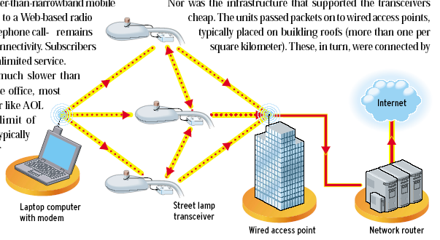
Ricochet Internet Access
Chapter 14 Broadband Wireless Access Networks
Source: IEEE Spectrum, March 2002
Notes
128 kbps Internet connection
Unlicensed 900 MHz spectrum
Access Points mounted on light poles
Established in 22 cities
Filed bankruptcy in 2001
Bought out by Aerie Networks
Network Management: Principles and Practice
© Mani Subramanian 2010
*

Slide 41
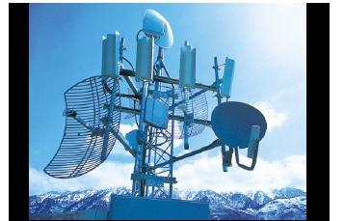
BBSC Broadband Solution
Chapter 14 Broadband Wireless Access Networks
Broadband Solutions Co. (BBSC) Hub
Notes
Broadband Solutions Co. (BBSC) broadband net- work in Utah uses fixed wireless access network
Has 6 wireless hubs over 1500 square kilometers
Supports 1400 customers
Supports hot spots of 2 – mbps connectivity
Operation at 2.4 and 5.7 GHz
Network Management: Principles and Practice
© Mani Subramanian 2010
*

Slide 42
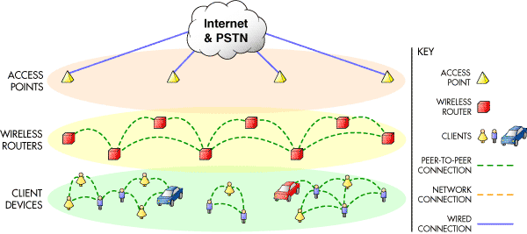
MeshNetworks Enabled Architecture
Chapter 14 Broadband Wireless Access Networks
Source: www.MeshNetworks.com
Notes
Supports
Backhaul access point infrastructure
Client meshing of wireless peer-to-peer networks
Supports handoff between access points from mobile auto
Test set-up in Florida supports 500 kbps in moving vehicle at highway speed
Network Management: Principles and Practice
© Mani Subramanian 2010
*

Slide 43
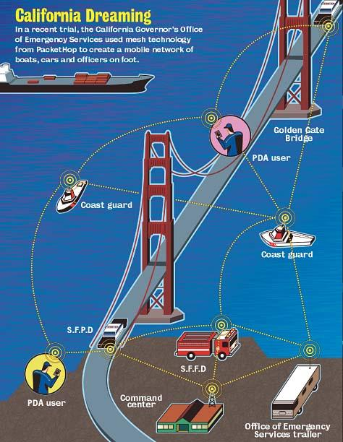
PacketHop
Chapter 14 Broadband Wireless Access Networks
Source: www.packethop.com
Notes
Network Management: Principles and Practice
© Mani Subramanian 2010
*

Slide 44
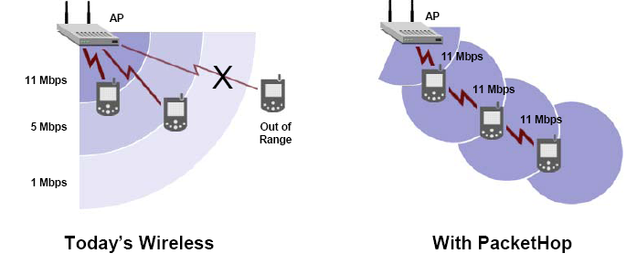
PacketHop Technology
Chapter 14 Broadband Wireless Access Networks
Source: www.packethop.com
Notes
Mobile units act as routers in a mesh configuration
Network Management: Principles and Practice
© Mani Subramanian 2010
*

Slide 45
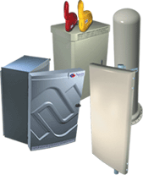
Navini Ripwave
Chapter 14 Broadband Wireless Access Networks
Source:www.navini.com
Notes
Fixed wireless
Components
Base Station
Element Management System
Modem
Operates in the unlicensed 2.4 GHz ISM band, or the licensed 2.3 GHz WCS, 2.5/2.6 GHz ITFS/MMDS bands
Network Management: Principles and Practice
© Mani Subramanian 2010
*

Slide 46
Mobile Wireless Networks
Chapter 14
Broadband Wireless Access Networks
We have already learned the important role that mobile IP plays in mobile communication.
Mobility management consists of two components, location management and handoff management.
Location management is a two-stage process.
First, it enables the network to discover the current attachment point of the mobile user for data delivery. The MA periodically notifies the network of the MN's new access point.
The second stage is data delivery. Here the network is queried for the mobile user's location profile and the current position of the Mobile host is found.
The second component is handoff (or handover) management that enables the network to maintain a user's connection as the mobile terminal continues to move and change its access point to the network. This is a three-stage process of initiation, connection establishment, And data-flow management.
During the initiation stage, either the user (a network agent) or changing network conditions identify the need for handoff.
In the connection-establishment stage, the network must find new resources for the handoff connection and perform any additional routing operations.
The final stage is data-flow control, where delivery of data from the old connection path to the new connection path is maintained.
Notes:
Chapter 14

Slide 47
Mobile and Wireless
Mobile Network
A network with ability to perform computing anytime/anywhere
May or may not use wireless transmission medium
Types of mobility
Cellular: Always-on
Nomadic: Session not active while in motion
Wireless Network
A network with wireless interface to computing devices and/or wired network
Deployed for networking both fixed and mobile users
Mobile and Wireless Broadband Network Management
Management of integrated wired/wireless and fixed/mobile broadband – voice, video, and data networks
Notes
Notes:
Chapter 14

Slide 48
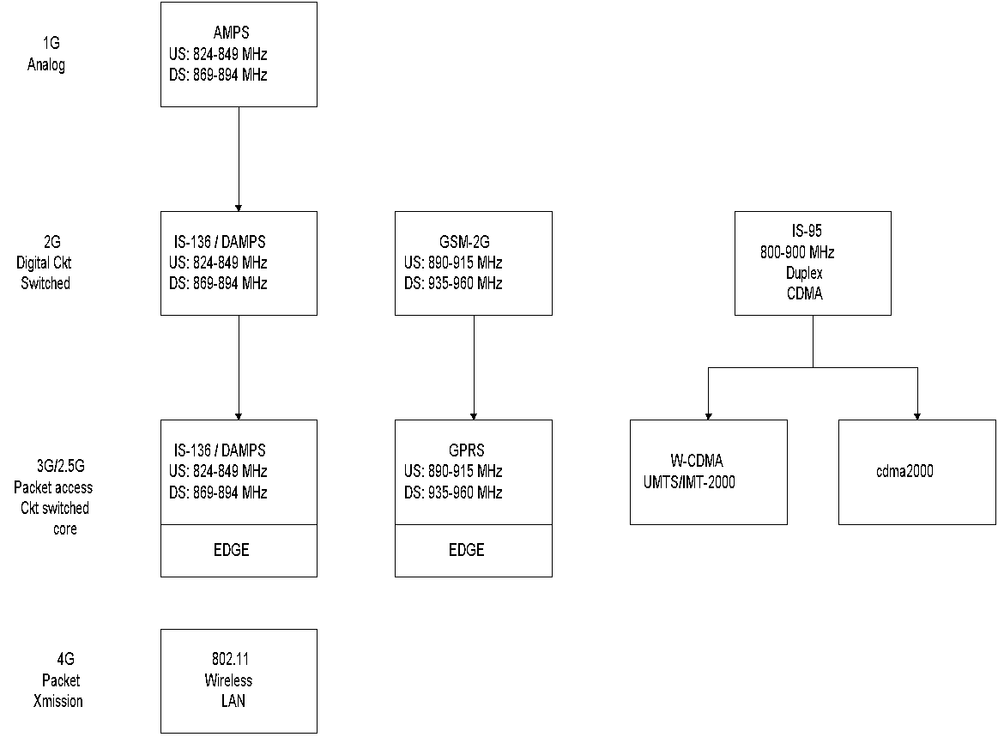
Mobile Wireless Evolution
Chapter 14 Broadband Wireless Access Networks
Notes
IS-136/DAMPS TDMA-based
GSM TDMA-based
IS-95 CDMA based
FDD (Frequency Division Duplex)
IS-136, GSM/GPRS, and IS-95
Notes:
Chapter 14

Slide 49
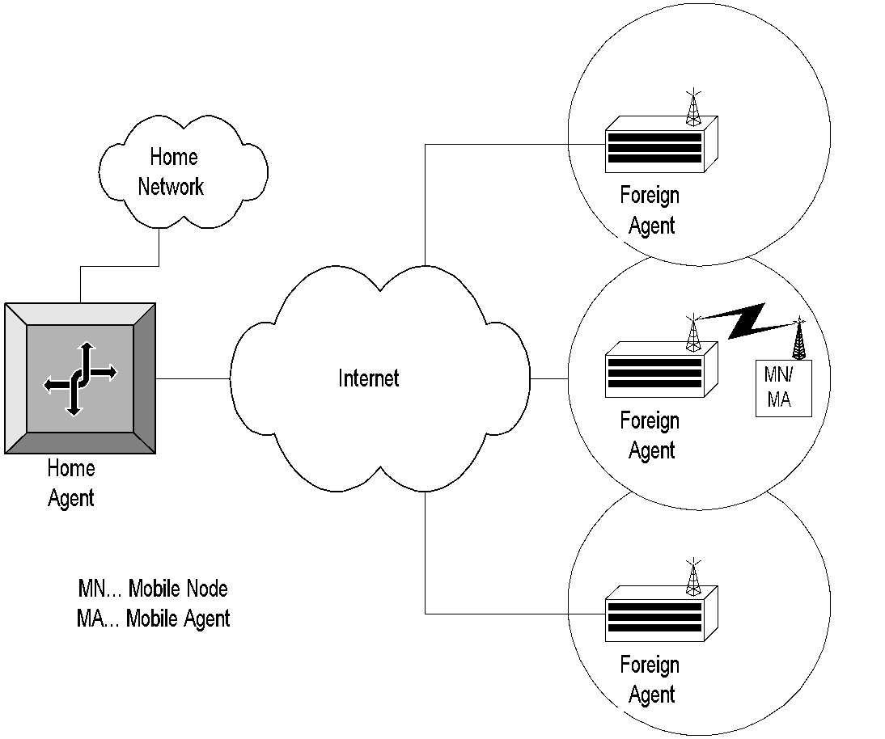
Cellular Network
Chapter 14 Broadband Wireless Access Networks
Table 14.17 Cellular Network
Notes
Notes:
Chapter 14

Slide 50
3G Management Issues
Chapter 14 Broadband Wireless Access Networks
Hierarchical LAN
Joint management with wired network
Mobile computing unit
Hardware limitations
Software limitations
Mobility management
Location tracking
Resource management
Wireless QoS management
Power management
Security management
Notes
Notes:
Chapter 14

Slide 51
Mobility Management
Chapter 14 Broadband Wireless Access Networks
Mobile IP
Location tracking
Discovery of Foreign Agents by Mobile Units
Broadcasting/advertising to locate an MU
Solicitation by MU
Handoff management
Packet control function (PCF) / Radio Network
Handoff of PCF to PCF within PDSN
Handoff of PCF between PDSNs
Notes
Notes:
Chapter 14

Slide 52
Mobile IP
Chapter 14 Broadband Wireless Access Networks
Mobile vs. nomadic
Mobile: activities not disrupted when point of attachment is changed
Nomadic: not active in motion; a.k.a. Portable computing
Analogy with telephone: Subscriber assigned an ID in both – phone number vs. IP address
Mobile IP is analogous to call forwarding, except the forwarding address is mobile
Notes
Notes:
Chapter 14

Slide 53
Mobile IP Functions - Roaming
Chapter 14 Broadband Wireless Access Networks
Mobile IP uses two addresses: a fixed home address and a care-of-address that changes the point of attachment
Mobile IP functions:
Mobile Agent ( Mobile Node) Discovery of foreign agent (FA)
Registration of current location with FA and home agent (HA)
Tunneling of packets to and from the HA to FA care-of-address as mobile node roams
Notes
Notes:
Chapter 14

Slide 54
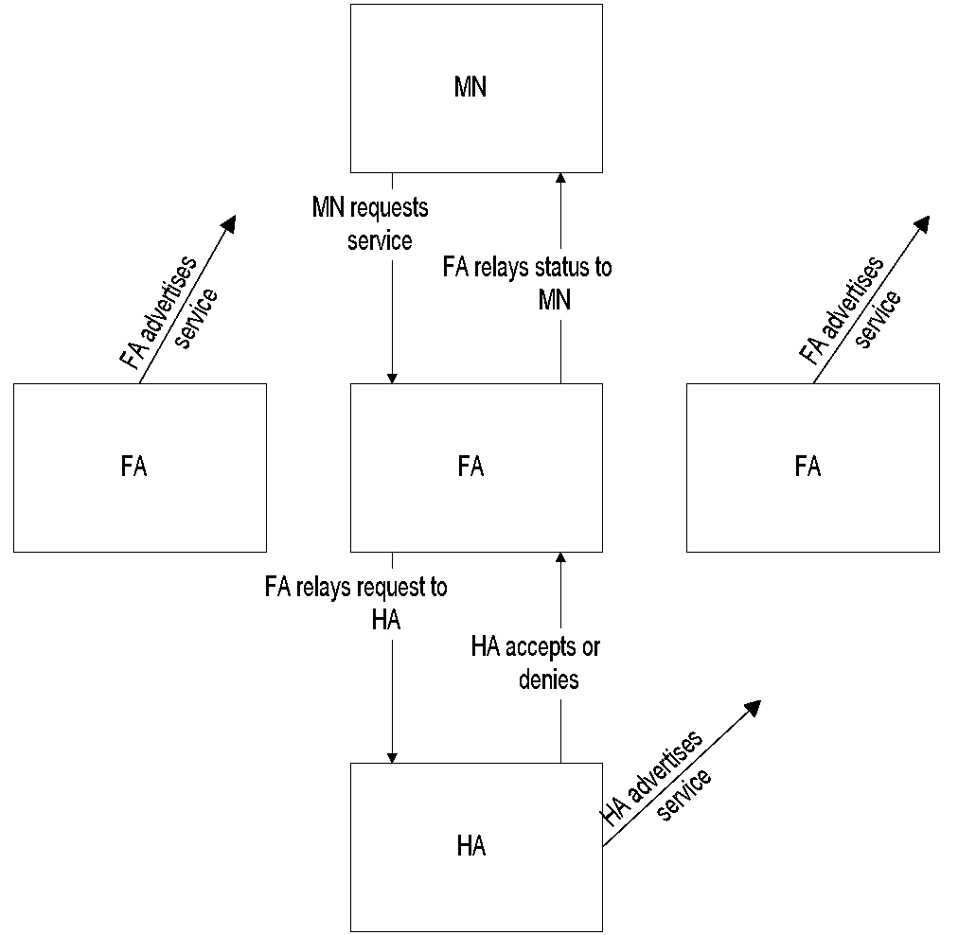
Discovery and Registration
Chapter 14 Broadband Wireless Access Networks
Table 14.18 Discovery and Registration in a Mobile System
Notes
Mobile node discovers foreign agent (FA) and its care-of-address by advertisements of FA
Mobile node can also discover by its solicitation
Mobile node registers FA with HA
Notes:
Chapter 14

Slide 55
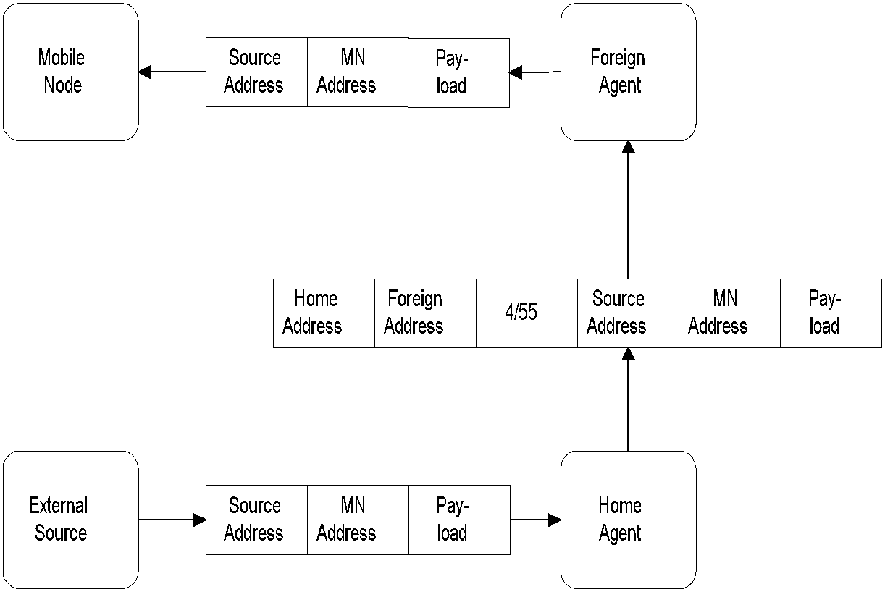
Tunneling
Chapter 14 Broadband Wireless Access Networks
Table 14.19 Tunneling in a Mobile System
Notes
Protocol number in the header:
4 indicates to higher level that the next header is an IP header with full encapsulation
55 indicates minimal encapsulation
Notes:
Chapter 14

Slide 56
SNMP Management of Mobile IP
Chapter 14 Broadband Wireless Access Networks
IETF Specifications using SMIv2 (RFC 1902) and MIB-II (RFC 1213)
Functional entities:
Mobile Node: A host or router that changes point of attachment from one network to another
Home Agent: A router on a mobile node’s home network, which tunnels packets to and from the mobile node via foreign agent
Foreign Agent: A router on a mobile node’s visited network, which provides services to the mobile node
Notes
Notes:
Chapter 14

Slide 57
Mobile IP MIB Groups
Chapter 14 Broadband Wireless Access Networks
Groups | Mobile Node | Foreign Agent | Home Agent
mipSystemGroup | X | X | X
mipSecAssociationGroup | X | X | X
mipSecViolationGroup | X | X | X
mnSystemGroup | X
mnDiscoveryGroup | X
mnRegistrationGroup | X
maAdvertisementGroup |  | X | X
faSystemGroup |  | X
faAdvertisementGroup |  | X
faRegistrationGroup |  | X
haRegistrationGroup |  |  | X
haRegNodeCountersGroup |  |  | x
Network Management: Principles and Practice
© Mani Subramanian 2010
*
Notes:
Chapter 14

Slide 58
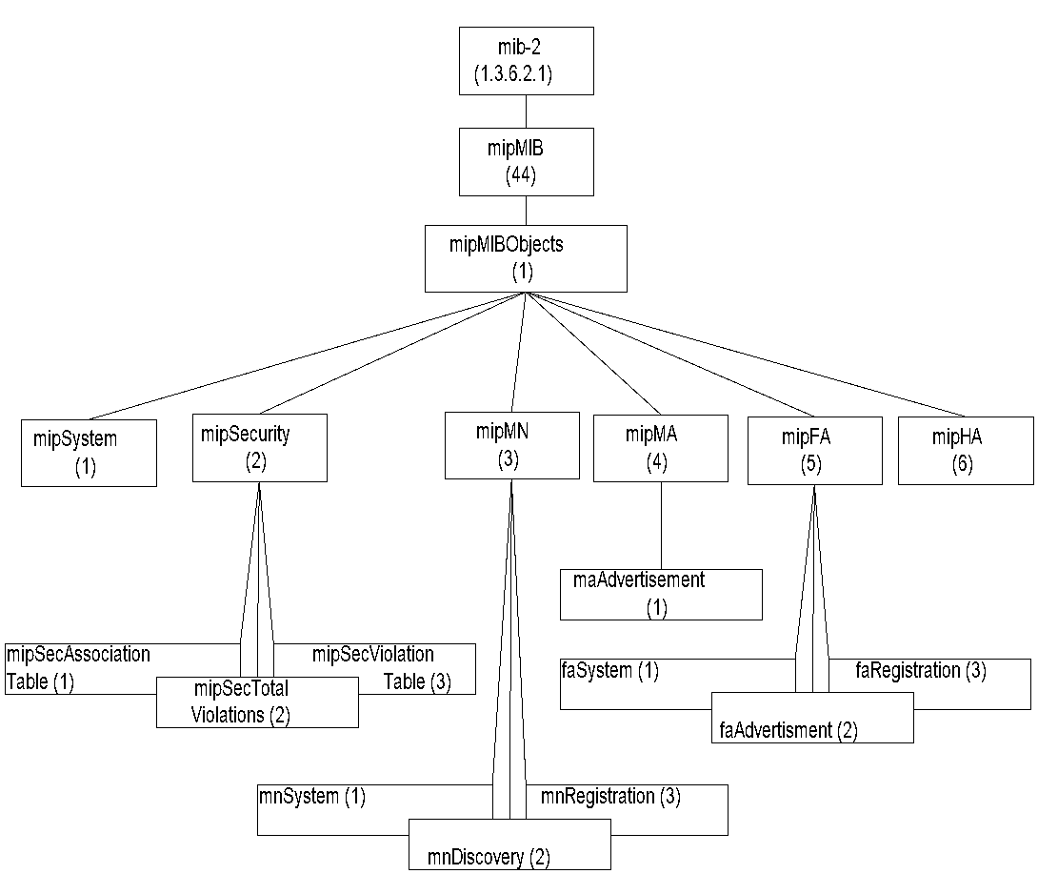
Mobile IP MIB
Chapter 14 Broadband Wireless Access Networks
Figure 14.20 Mobile IP MIB
Notes
Notes:
Chapter 14

Slide 59
mipMIBObjects
Chapter 14 Broadband Wireless Access Networks
Table 14.4 mipMIBObjects
Entity | OID | Description
mipMIBObjects | mipMIB 1 | Objects under mipMIB
mipSystem | mipMIBObjects 1 | Mobile IP system related parameters
mipSecurity | mipMIBObjects 2 | Mobile IP security parameters
mipSecurity AssociationTable | mipSecurity 1 | Security associations table
mipSecTotal Violations | mipSecurity 2 | Total number of security violations in the entity
mipSecViolation Table | mipSecurity 3 | Security violation information
mipMN | mipMIBObjects 3 | Mobile node group
mnSystem | mipMN 1 | Mobile node system information
Notes
Notes:
Chapter 14

Slide 60
mipMIBObjects
Chapter 14 Broadband Wireless Access Networks
Table 14.4 mipMIBObjects (cont.)
Entity | OID | Description
mnDiscovery | mipMN 2 | Mobile node discovery counter on solicitations, advertisements, and moves
mnRegistration | mipMN 3 | Mobile node registration table
mipMA | mipMIBObjects 4 | Mobile agent group
maAdvertisement | mipMA 1 | Mobility agent advertisement configuration table present in both MN and FA
mipFA | mipMIBObjects 5 | Foreign agent group
faSystem | mipFA 1 | Foreign agent system information
faAdvertisement | mipFA 2 | Foreign agent advertisement information plus MA advertisement group
faRegistration | mipFA 3 | Foreign agent visitors list
mipHA | mipMIBObjects 6 | Home agent registration group and mobility binding list
Network Management: Principles and Practice
© Mani Subramanian 2010
*
Notes:
Chapter 14

Slide 61
14.3.3 Resource and Power Management
Resource management deals with scheduling and call admission control (CAC), load balancing between access networks, dynamic control of RF spectrum, and power management.
This impacts management of bandwidth to provide multimedia broadband service, as well as handoff between cells to achieve quality of service.
In mobile cellular networks, when a mobile user moves from one cell to a different cell, ''handoff تسليم ' of the user needs to be accomplished without dropping the session. CAC is the process that controls whether an incoming call can be admitted or not.
The resource control mechanism has to allocate the limited bandwidth resources to users in an efficient way in order to guarantee the users' QoS requirements. If the handoff target cell does not have enough bandwidth to support this call, the call will be forced to terminate.
Handoff calls are commonly given a higher priority in accessing bandwidth resources in order to provide a seamless connection for users. Call dropping during a handoff is mitigated by reserving bandwidth specifically for that function in each cell.
For broadband service, handoff management becomes more complicated. The system needs to support, in addition to handoff in the same class of service, multiple classes of service where each class presents different QoS requirements.
Handoff may also need to be done in intra-cell roaming of an MN. If the signal falls below a threshold level of a subscriber's SLA, transmission can be dynamically switched to another frequency that is stronger.
Power management involves multiple components. discusses power control, power-saving mechanisms, energy efficiency, and radio resource management.
Power control deals with mechanisms to dynamically control transmitter power to reduce interference.
Power-saving mechanisms and energy-efficient designs extend battery life.
Radio resource management optimizes transmission by selecting the best spectral components.
Unfortunately, there are no standard MIBs defined for monitoring and managing the above resources. Proxy agents can be developed and used by vendors to implement these requirements.

Slide 62
Resource Management
Chapter 14 Broadband Wireless Access Networks
Scheduling and call admission control
Reservation of guard channels for handoff - static
Dynamic control of call admission – complex to control multimedia service
Proposals for QoS-based handoffs
Load balancing between access networks
Power management
Notes
Notes:
Chapter 14

Slide 63
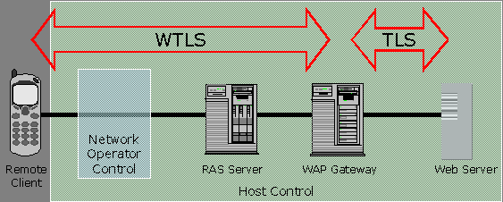
Security Management
Chapter 14 Broadband Wireless Access Networks
Security requirements for mobile wireless communication involve security in different parts of the network, both wired and wireless. Broadband communication system is based on digital communication technology TDM, TDMA, and CDMA. Air interface security is based on the wireless application.
Wireless application protocol (WAP) and secured socket shell (SSL) are the two approaches that are commonly used for secured wireless communication. Although SSL is used extensively in a wired network, WAP is the common implementation in mobile wireless. It is based on transport layer security (TLS) protocol. It does the normal security functions, which include authentication, authorization, privacy, and address integrity.
Figure 14.21 shows WAP architecture. The MN is connected to the WAP gateway through a network operator control and a remote access server. The security protocol used is wireless TLS (WTLS). The TLS protocol is used between the WAP gateway and remote server that the mobile subscriber is trying to access. Most security failures happen in the transition Between the two. Robust security can be achieved by careful design and implementation of the WAP gateway using available security tools.
WTLS could be implemented for the wireless leg of the link and SSL could be implemented between the WAP gateway and the remote server. In this case, the WAP gateway module has to perform decryption and encryption, as well as protocol conversion.
3GPP and 3GPP2 have plans to implement IP network. Under that situation, open standard SNMP3 discussed in Chapter 7, which has built-insecurity, would be used for mobile network management.
Figure 14.21 Security Management in a Mobile System
Notes
WAP (Wireless Application Protocol) Security
WAP Wireless transport layer security (WTLS)
Based on transport layer security (TLS) or secured sockets shell (SSL)
“Walled garden” “vertical” integrated approach
3G network security
3GPP (Third Generation Partnership Project) and 3GPP2 plan for IP to wireless device
Open standard SNMP based
Notes:
Chapter 14

Slide 64
QoS Management
Chapter 14 Broadband Wireless Access Networks
Table 14.5 UMTS QoS Specifications
QoS Class | TransferDelay | Transfer Delay Variation | Low BER | Guaran-teed Bit Rate | Example
Conversation | Strin-gent | Strin-gent | No | Yes | VoIP, Video- and Audio-conferencing
Streaming | Con- strained | Con-strained | No | Yes | Broadcast service, news, sport
Inter- active | Looser | No | Yes | No | Web browsing, interactive chat, games
Back-ground | No | No | Yes | No | email, SMS, TFP transactions
Third-generation mobile networks, 3G and beyond, are required to transmit voice, video, and data under the specifications of universal mobile telecommunications system (UMTS) developed by the Third Generation Partnership Project [3GPP].
The 3GPP has defined four QoS classes: conversational, streaming, interactive, and background.
The QoS discussed here is applicable only between the BS and the mobile stations. QoS on the core network is achieved using wired network methodologies, such as intserv (integrated services) or DiffServ (differentiated services).
Notes
QoS support for last leg between access point and mobile node
Depends on mobility and resource management
3GPP/3GPP2 (3G Partnership Project) standards ensure interoperability
3GPP has defined four QoS classes (TS 23.107) shown above
Telephony handled using SIP (session initiation protocol)
Backbone based on DiffServ
Notes:
Chapter 14

Slide 65
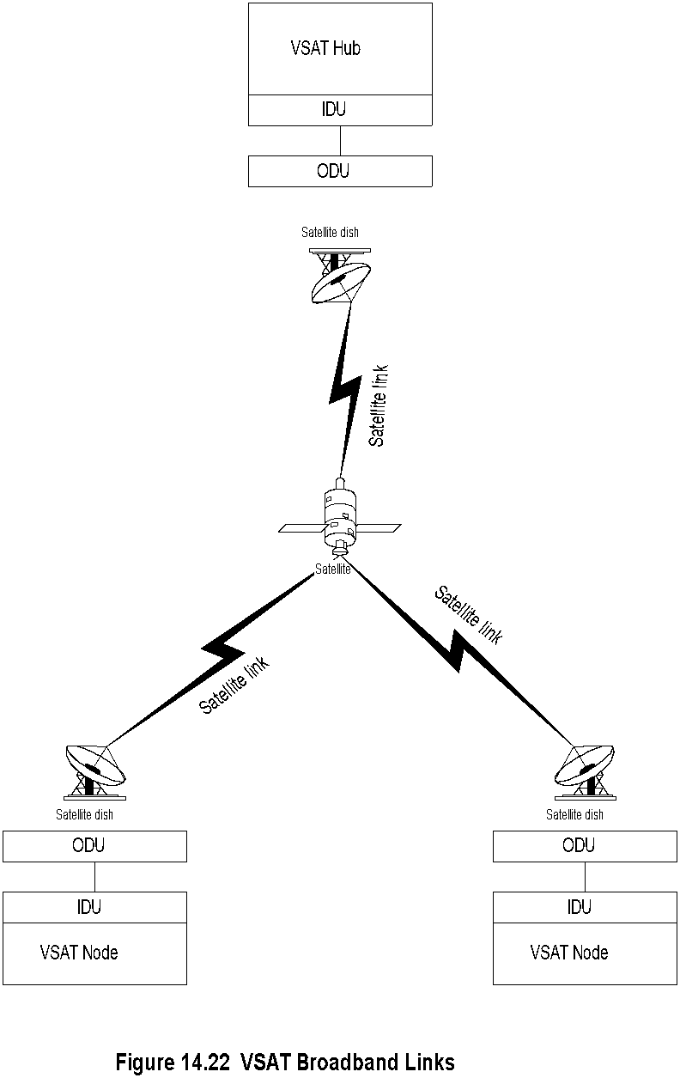
VSAT
Chapter 14 Broadband Wireless Access Networks
SATELLITE NETWORKS
Although satellite communication is currently not ideally suited for broadband communication, it is emerging as one in a limited manner.
For example, VSAT (Figure 14.22) is a popular implementation of direct transmission to home (DTH) satellite access network. Some reasons for the revival of DTH are easy implementation, small and highly directional antenna, and video compression technique. Itis used as a back-up link for communication by industrial organizations, as well as to set up communication to rural and inaccessible areas such as mountainous regions.
VSAT operates in the Ku and Ka bands.
VSAT uses geostationary earth orbit and hence appears stationary for the ground station.
Rain attenuation, VSAT also suffers from an end-to-end round-trip delay time of 0.5 seconds; i.e., from one terminal to another and back.
Notes
KU Band and KA band
40 – 60 kbps uplink and 500 kbps downlink
Notes:
Chapter 14

Slide 66
VSAT Components
Chapter 14 Broadband Wireless Access Networks
ODU Outdoor unit
Power amplifier
Up-converter
Down-converter
IDU Indoor unit
Modems
Frequency synthesizer
Encoder / decoder
Proxy agent for management; Later models with SNMP agent
Notes
The outdoor unit (ODU) consists of a power amplifier and an up-converter feeding into the antenna and low-noise block down-converter receiving signals from the antenna.
the indoor unit (IDU) includes the following components: modulator, demodulator, frequency synthesizer, encoder, and decoder.
The normal interface to the customer network is Ethernet.
Objects to be managed are parameters associated with the antenna, transceivers, frequency converters, and power amplifiers.
Notes:
Chapter 14

Slide 67
summary
In this chapter, we addressed the basic principles of wireless communication that are required to understand wireless access networks and their management. The key areas covered are free-space propagation that is applicable to satellite and mobile communications and two-ray propagation that terrestrial wireless access networks are based on. We also discussed the fading phenomenon that separates wireless access networks from those of wired access networks.
We discussed the three major categories of fixed wireless broadband access networks, namely MMDS, LMDS, and IEEE802.16/ WiMax. MMDS has been deployed in rural areas and has adopted wired cable technology defined by DOCSIS standards. LMDS is also based on DOCSIS standards although other technologies such as GPRS are used. Network management of DOCSIS-based MMDS and LMDS has taken advantage of standards developed for the management of cable access networks. WiMax network is an outgrowth of IEEE 802.16, which is the generalized standard for fixed wireless access networks. This technology is seriously considered for metropolitan access network and will compete with cable and DSL technologies. However, it has been slow in getting deployed due to technical, as well as competitive reasons. MIBs have been specified for this to implement remote network management.
We discussed mobile cellular wireless network primarily from the IP network point of view, although proprietary technologies are mostly used for predominantly voice-based network. Mobile IP plays an important role in the implementation of broadband mobile wireless including management of it. This was addressed in detail.
VSAT was described as emerging DTH technology for broadband access network. It has several advantages and disadvantages for use in broadband communication. Because of its geographical distribution, remote network management system is a necessity. However, due to bandwidth constraint, features of the system are usually limited.

